Slide 1
Vernal Pools and Big Night Nottingham Conservation Commission
Kristen Lamb, B.S. Wildlife Ecology
Executive Director, Center for Wildlife

Slide 2
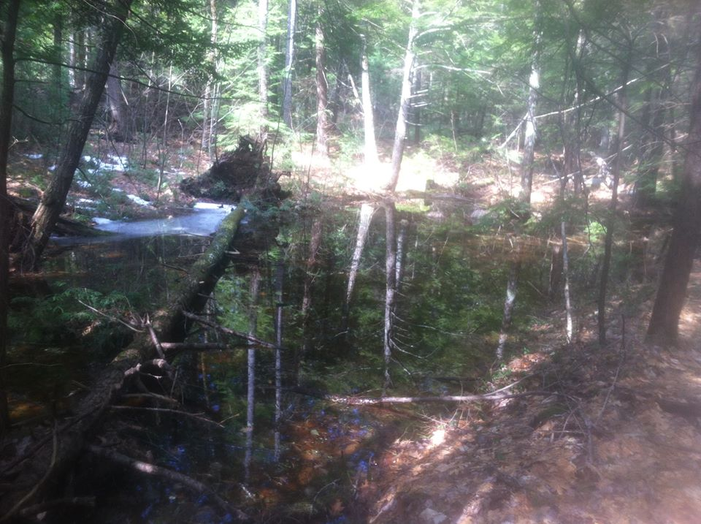
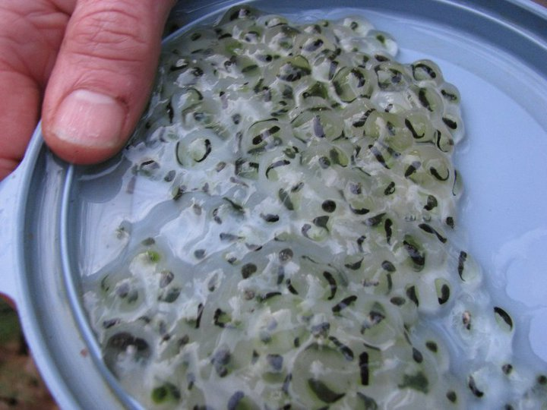
What’s a Vernal Pool?
Definition
Identification
Determining Factors

Slide 3
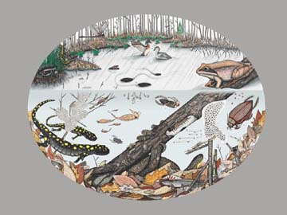
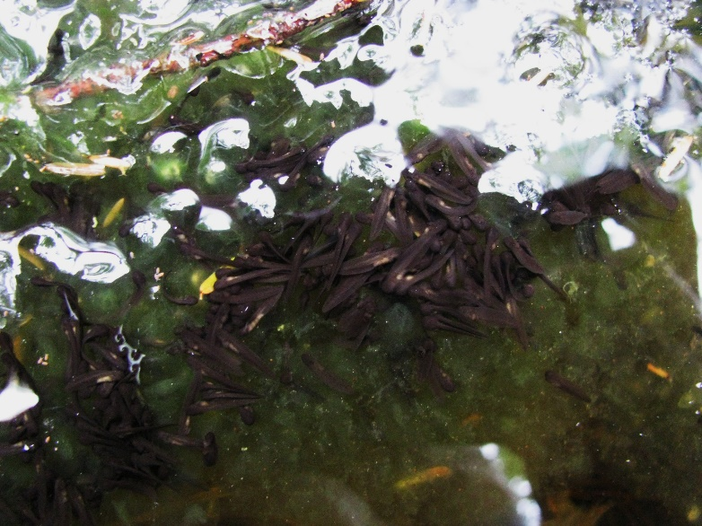
What’s the Big Deal?
Important ecosystems
Threatened and Endangered
Nurseries
Upland Species

Slide 4
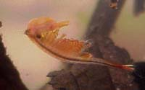
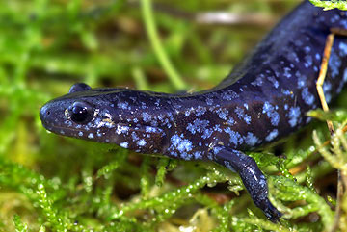
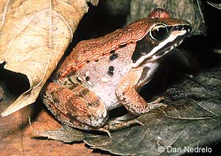
Obligate Species
A species that requires a vernal pool during a life stage
Fairy shrimp
Wood frogs
Blue spotted salamander

Slide 5
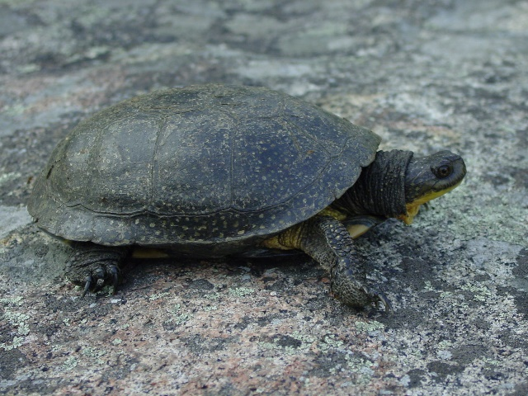
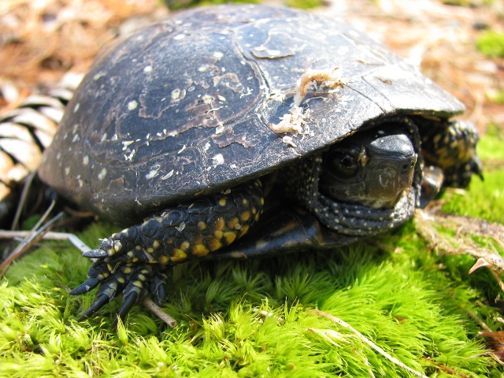
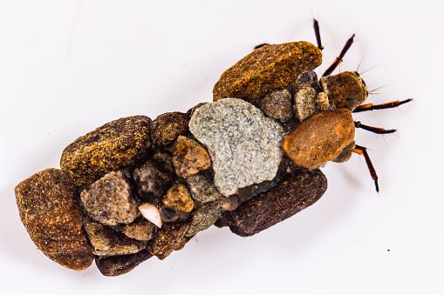
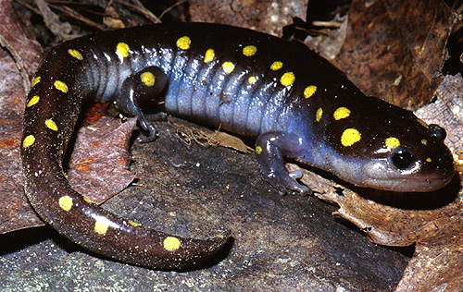
Facultative Species
Preference toward but not a need to utilize vernal pools for foraging, hibernation, breeding
Wood turtle
Blanding’s turtle
Spotted salamander
Caddis fly

Slide 6
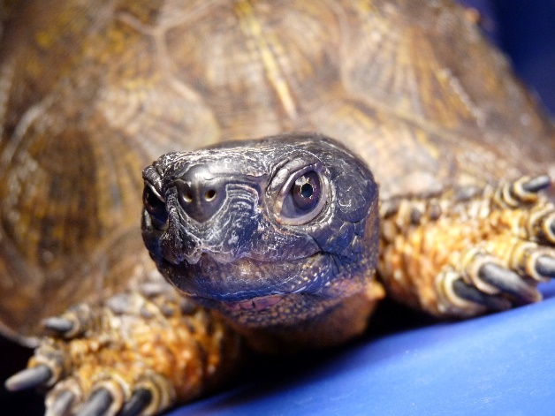
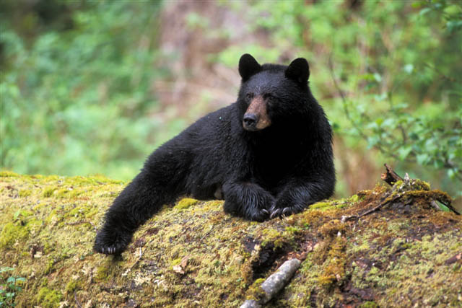
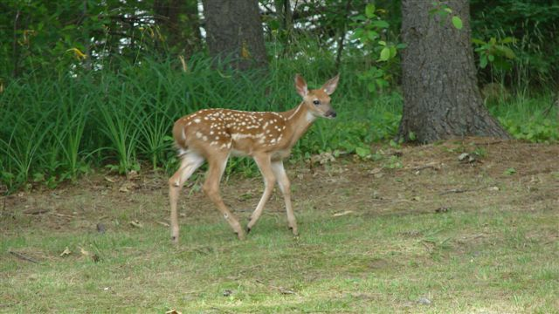
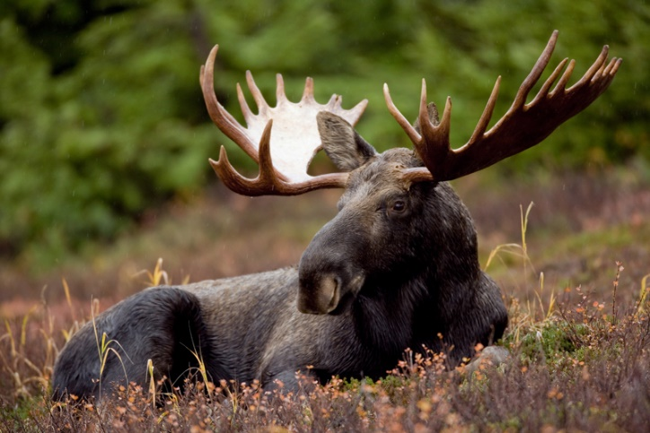
Upland Species

Slide 7
Vernal Pool Protection
Nottingham
Critical wetlands identified and inventoried in 1999
Development in critical wetlands or 100-foot buffer
50-75 foot setbacks for poorly drained soils
DES recommends the Army Corps of Engineers (New England District) BMPs including:
Avoid disturbance within the VP depression and envelope (extends 0-100 feet from the VP depression’s edge)
Limit development to less than 25% of the CTH (extends 100-750 feet from the VP depression’s edge)
Exclude roads and driveways from the VP envelope
Minimize impedance to amphibian terrestrial passage. Cape Cod style-curbing3 or no curbing options should be used for new road construction

Slide 8
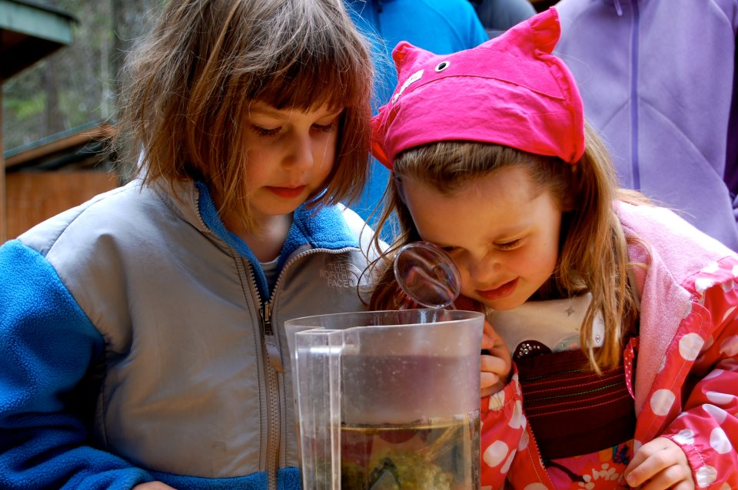
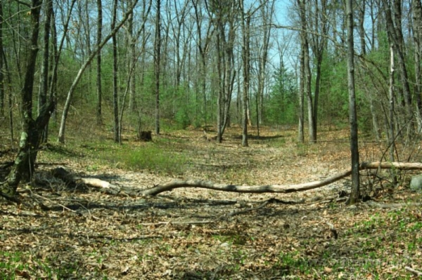
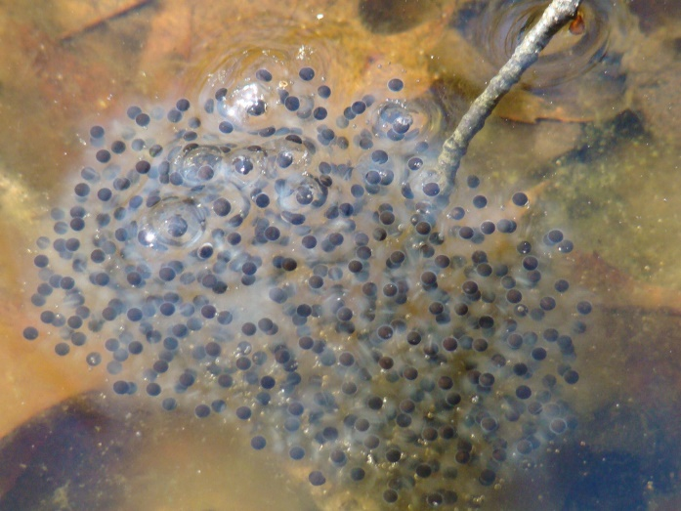
Citizen Science
Visual and Time of Year
Listening
Spotting egg masses
Reporting

Slide 9
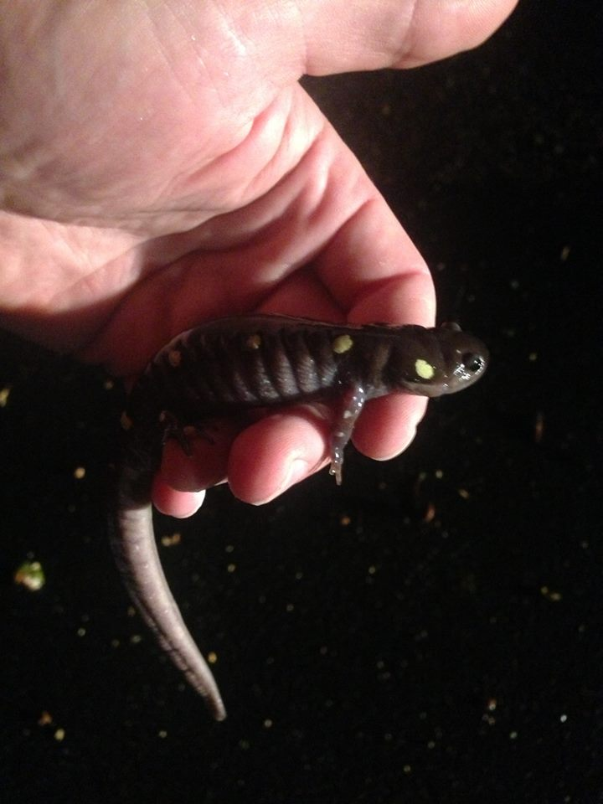
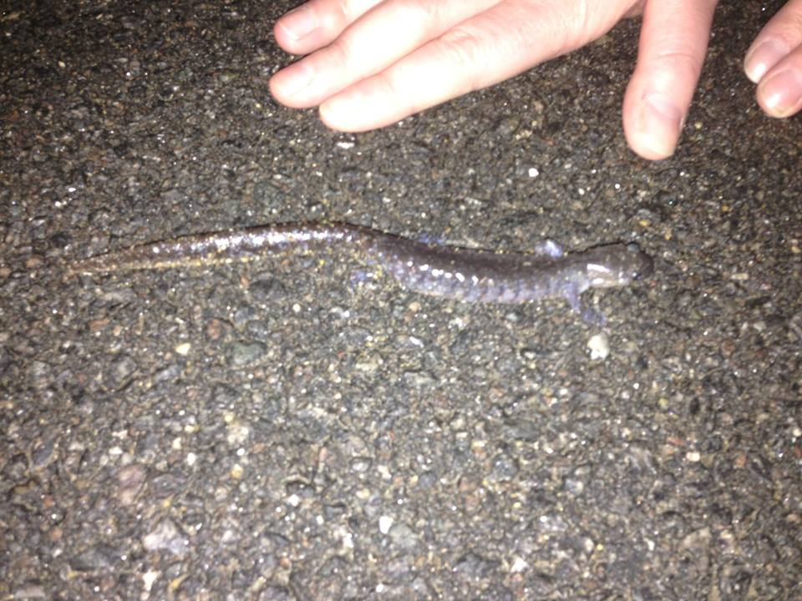
Big Night
When?
Earth warms, typically early spring, rainy nights, ~50 degrees
What Happens?
Awake from hibernation, mass amphibian migration
Become a Steward
Tune in
Wear gloves/ clean hands
Be prepared

Slide 10
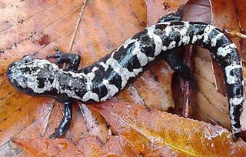
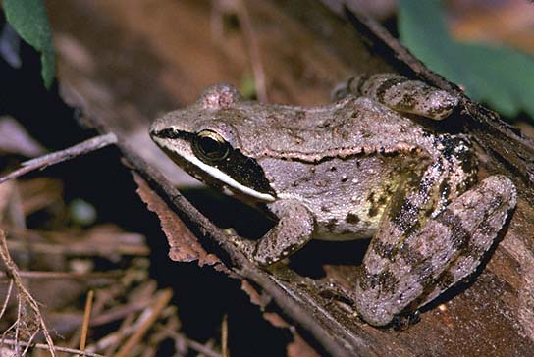
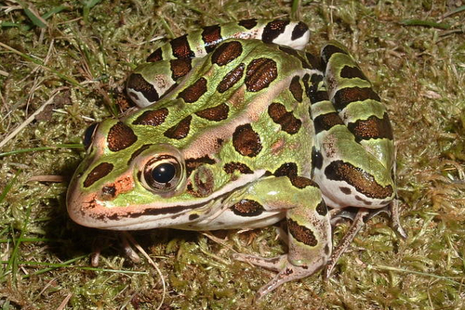
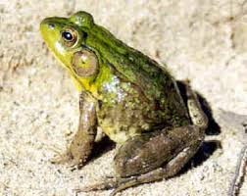
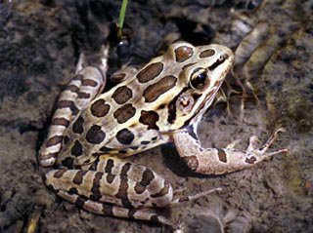
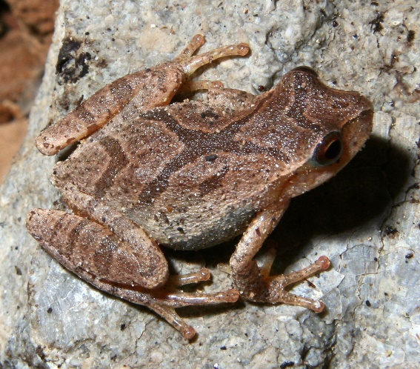
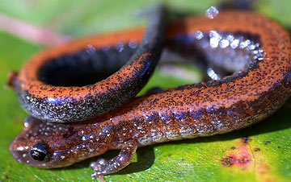
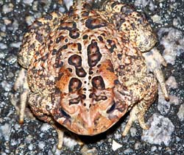
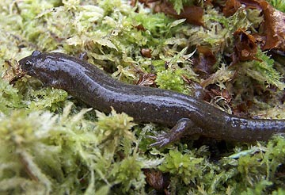
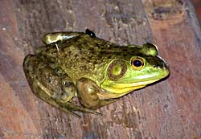
Local Amphibian Species

Slide 11
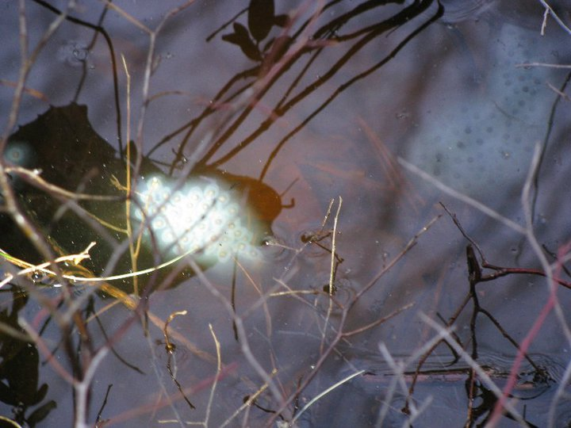
Let’s Find Your Neighborhood!
Wildlife Action Plan Map
Wetland/vernal pool to upland roads
Nottingham hot spots
Reporting
Photographic documentation
nhwildlifesightings.unh.edu
2016 vernal pool manual worksheet
Big Night Tally Sheet
Salamander Crossing Brigade
thelen@harriscenter.org
info@bear-paw.org

